Slide 1







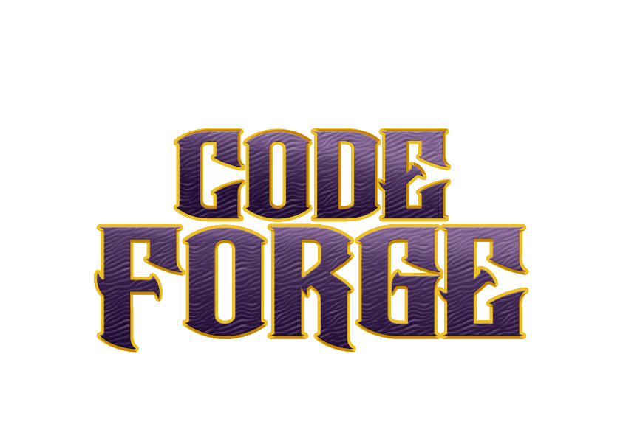

Idea submission

Slide 2


Team details
Team Lead: Name:Abhishek C
Contact: 87629 60613
Email:abhishekc.ad23@bmsce.ac.in
Team Member 2: Name:Amoggh N Bharadwaj
Contact: 83107 13896
Email:amogghbharadwaj.ad23@bmsce.ac.in
Team Member 3: Name:Akasha Basavaraja paleda
Contact: 7204429971
Email:akashabasavaraja.ad23@bmsce.ac.in

Slide 3


Our solution
Overview of the problem statement: Difficulty in accessing legal information efficiently.
Solution: A chatbot trained on the Indian Constitution to provide legal guidance.
Use of FAISS Indexing and Sentence Transformers for quick and accurate retrieval of legal sections.

Slide 4

TECHNICAL APPROACH
Natural Language Processing (NLP)
Sentence Transformers (all-MiniLM-L6-v2)
FAISS (Facebook AI Similarity Search)
Python
Regular Expressions (Regex)
Flask/FastAPI (if applicable for deployment)

Slide 5
Workflow/pipeline
1. Data Preprocessing: Extraction and formatting of legal sections from a text file.
2. Embedding Generation: Using Sentence Transformers to convert text into vector representations
3. Indexing with FAISS: Efficient similarity-based retrieval of legal sections.
4. Query Handling: User queries are converted into embeddings and searched in the FAISS index.
5. Response Generation: The chatbot returns the most relevant legal sections.

Slide 6
Feasibility & FUTURE SCOPE
Feasibility
FUTURE SCOPE
Accuracy: High due to NLP-based retrieval.
Scalability: FAISS allows quick searches even on large datasets.
Usability: Helps users find legal information without needing deep legal knowledge.
Challenges: Requires structured legal text for effective extraction.
Improved Legal Reasoning: Enhancing responses using LLMs like GPT.
Multilingual Support: Expanding to regional Indian languages.
Integration with Case Laws: Enhancing legal advice using real-world precedents.
Voice-Based Interaction: For accessibility and ease of use.

